Slide 1
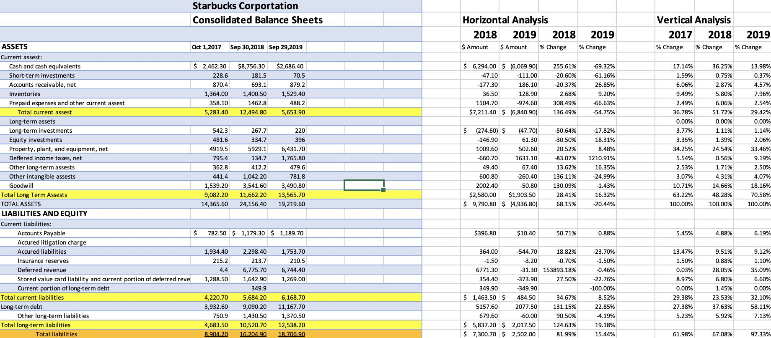
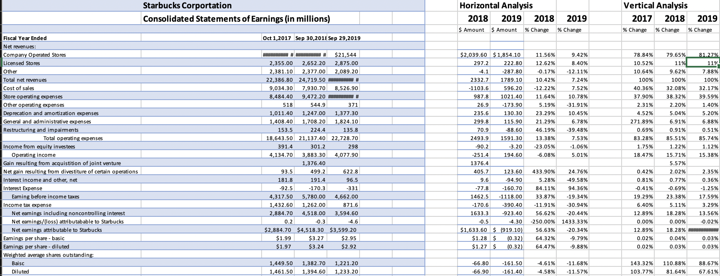
Project 1- Excel sheet
An interesting finding from completing Project 1 was that there was many factors that is contributed to maintain a company's financial statements.
Project 1 also showed that having three years of data can show how profitable or non-profitable a company is.
Creating financial statements such as a balance sheet helped us to understand how and what goes into accounting.
While doing Project 1 helped our group to develop skills on how to conduct horizonal and vertical analysis.
This project has also helped our group to develop the necessary thinking about how to organize financial data and how to present it to others in an efficient and understandable way.
As a result, from conducting this first Project it gave us an insight experience on how to organize financial data into income statements, balance sheets, ratios, horizontal and vertical analysis etc. While also having us understand the complexity of financial data and what they can show about a company.

Slide 2
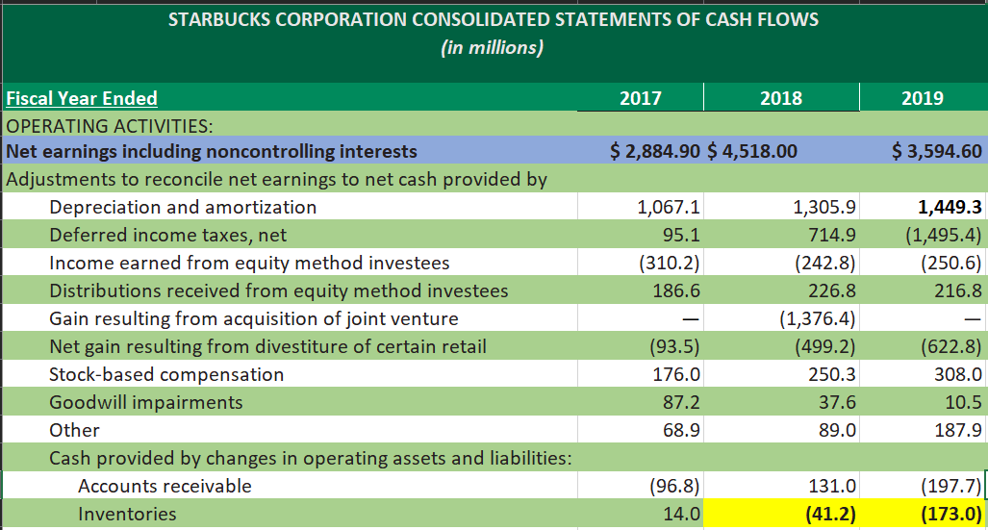
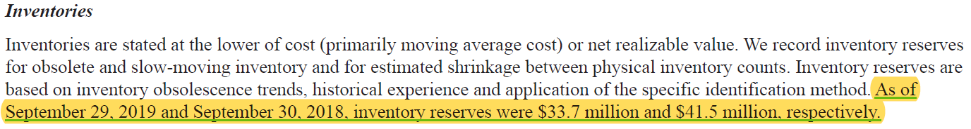
Project Two - Inventory discrepancy by management
Project Two Cash Flow
2018 Inventory = 41.2m
2019 Inventory = 173.0m
Page 53
2019 Starbucks 10k report
Management Inventory
2018 Inventory = $41.5m
2019 Inventory = $33.7m
Starbucks management reports does not match the 10-k report cash flow (inventories)
This discrepancy shows management is hiding information from public, investors & shareholders
Managements information is contradicting the 10-k report cash flow
This is misleading and should be investigated

Slide 3
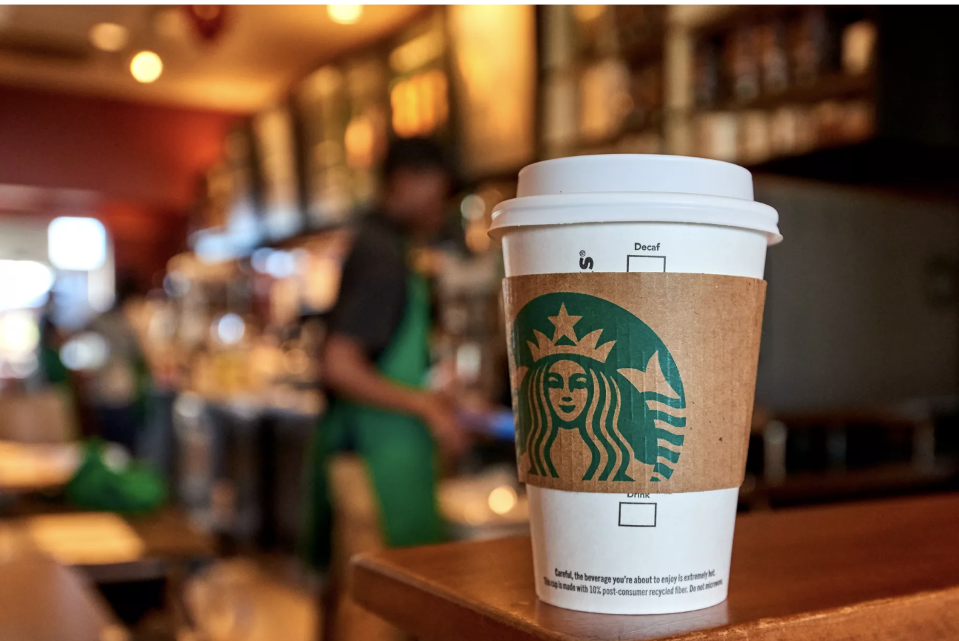
Project Two
Cash Flow Operating Activities are inconsistent by Management
Financial Statement
Management Discussion:
2017
Cash flows from operations were $4.2 billion in fiscal 2017
Statement of Cash flow
Years | 2017 | 2018 | 2019
Depreciation and amortization | 1067.10 | 1305.9 | 1,449.30
Account receivable | -96.5 | 131 | -197.7
Inventories | 14 | -41.2 | -173
Net cash provided by operating activities | 4,254.80 | 11,937.80 | 5,047
2018
Cash flows from operations were $11.9 billion in fiscal 2018 compared to $4.3 billion in fiscal 2017.
Cash flows from operating activities reports the cash inflows and outflows from a company's day-to-day operations.

Slide 4
This What-IF scenario simulates the theft of coffee (CPG) by 20% of the original stock
A decrease in the CPG/Foodservice by 20%, CPG = (Consumer Packed Goods) adversely effects the listed financial data
Food/beverages are displayed on glass for consumers to select from their wide range of products
Inventory directly affects income, profit margins, and financial ratios

Slide 5

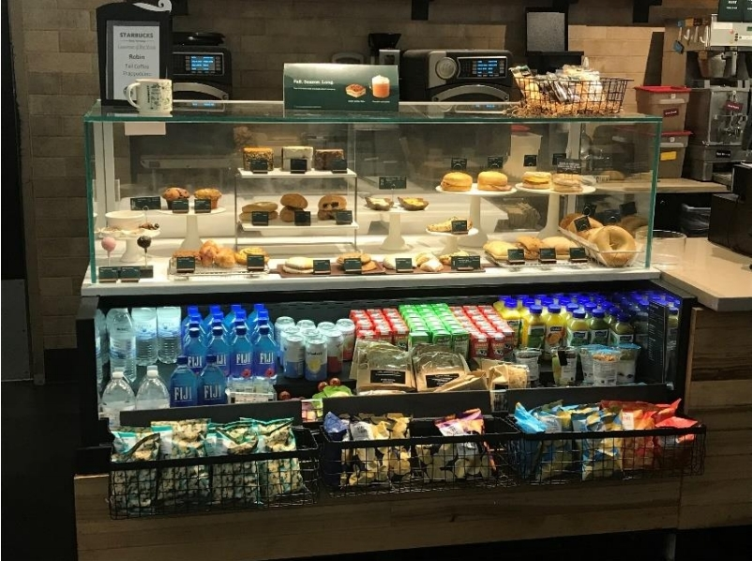
Project 3 What has store-level risk analysis shown?
FIFO is a food industry standard for perishable commodities as opposed to LIFO which is meant for non-perishable items. Whether or not Starbucks is using these methods, they must be aware of them in order to prevent shrinkage.
We cannot determine profit margins nor calculate how much it costs to replace stolen/damaged goods without the cost of goods (COG).
If the goal is to spend less on depreciation, then we would need to invest a little more into machinery in order to maintain the same quality goods while decreasing deprecation costs.

Slide 6
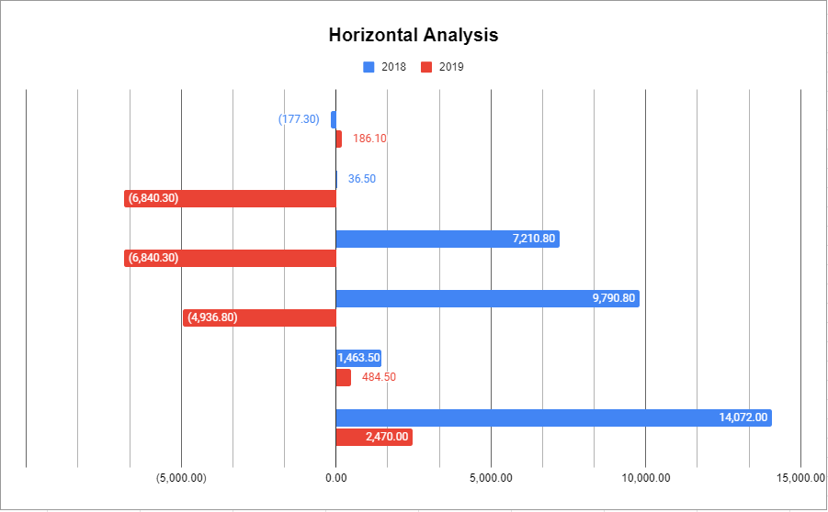
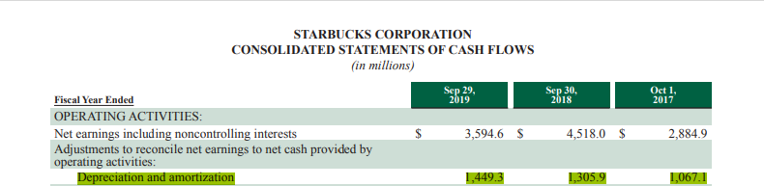
What is the takeaway from this?
Since we were able to determine the store-level risks, we can determine future problems. Starbucks has shown a reduction in growth. The cash flows statement shows how much more Starbucks had to pay in expenses in the last few years.

